Slide 1
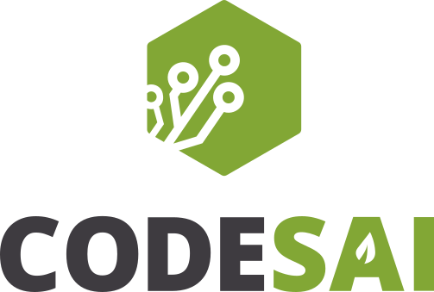
Tactical Patterns Explained
A brief introduction

Slide 2
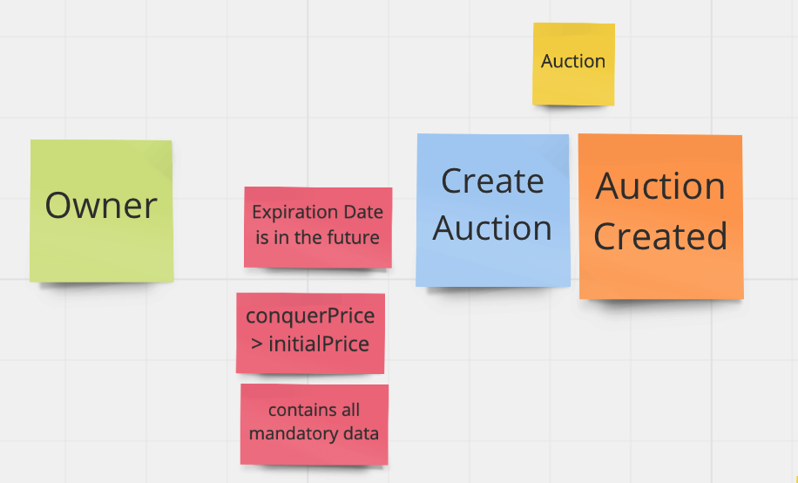
CreateAuctionActionShould
CreateAuctionCommand
Money
CreateAuctionAction
Policies
Auction
Auction Repository

Slide 3
Revisiting our model
Event Storming:
https://miro.com/welcomeonboard/ngfd0lmv0aRgqBedOiR2sJiMwJElbnZhjddYmkR1Pbx0avojBC7HKB4IECyaPwA9
The code:
https://github.com/Codesai/auction_house_ddd

Slide 4
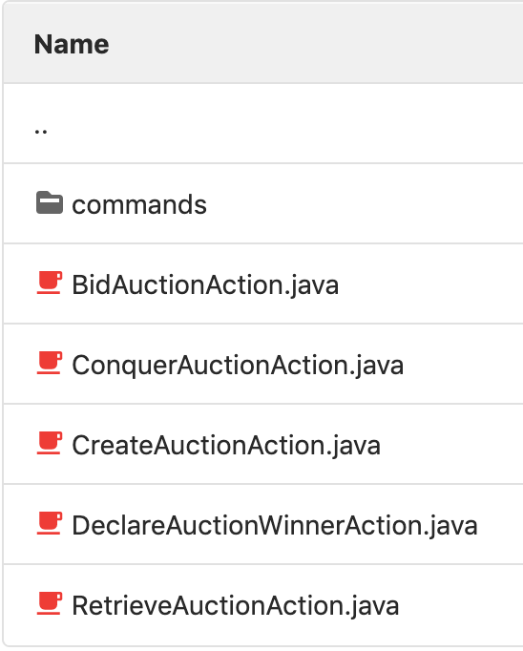
Actions
Represent the entry points of the domain model
The Action is a thin layer that sits above the domain model and coordinates the application activity. It does not contain business logic and does not hold the state of any entities
Usually the name of the is composed with:
A verb that defines the action
A noun with the element of the domain affected by this action
the word Action

Slide 5
Actions
Actions corresponds with the DDD tactical pattern “Application Services”
Why actions instead of Application Services
“service” is an overused term in software design and really confusing:
Services in Domain-Driven Design (DDD)
The idea of Action comes from Interaction-Driven Design, a technique proposed by Sandro Mancuso:
Introducing Interaction-Driven Design

Slide 6
Commands
In our context a command represents the data received by the Action. Is not exactly a command pattern as in the Design Patterns book.
The command properties can be basic types or generic domain value objects. (like money, datePeriod…).
A command object is usually inmutable.
A command is more like a data structure that can holds some simple validation logic, but not domain related logic:
A command can validate a date is in an appropriate format.
A command can not validate business rules like a date must be in the past or in the future.

Slide 7
Value Objects
Represent the elements of the UL with types in your code, avoiding primitive obsession.
Objects that are equal due to the value of their properties are called value objects. They have no identity
Value objects are immutable.
They are behaviour attractors. Operations between different value objects or the value object itself are dominated by the logic within the value object.
https://martinfowler.com/bliki/ValueObject.html

Slide 8
Value Objects
Self-validating. Value objects are instanced after validating if their reason to be created matches with its internal logic and its cohesive.
Examples:
Money
Coordinates
Color
ComplexNumber
Distance
Locale

Slide 9
Repository
Repositories are responsible for retrieving and storing aggregates.
The repository interface is defined in terms of the domain and belongs to the model.
The repository implementation retrieve the data for the external persistence systems and transform this raw data into an aggregate.
The repository implementations are injected into actions or domain services to achieve the hexagonal architecture style using dependency inversion.
When there are differents implementations of a repository interface, is important to adhere to the liskov substitution principle.

Slide 10
Repository vs DAO’s
In other architectures is very common the concept of Data Access Object to access data within an application.
Differences with repository:
DAO’s are modelled starting from the data. a typical example of an application using this pattern is to have one DAO per table.
Repositories are modelled starting from the aggregates

Slide 11
Aggregates
Cluster of objects treated as a single unit.
In the aggregates resides different kinds of components such as:
Entities
Value Objects
The Aggregate Root (?)
Aggregates can only be accessible through the aggregate root

Slide 12
Aggregates
Resides (mostly) all the domain logic within it.
The aggregate is where restrictions (invariants) allow or not to fulfill a domain order (command) to be executed
Data and Logic live together and the integrity of the data is owned by the aggregate.
Data only can change inside the aggregate

Slide 13
Aggregates
An aggregate cannot exists if its data does not fulfill the domain logic
An aggregate does not know about concrete implementations.
And aggregate lives on the domain layer, it must not know anything about infrastructure details

Slide 14
Aggregates: Transactionality vs Integrity
Common mistake in DDD adopters
Transactionality ensures data changes it a certain way and nothing can interfere
Integrity ensures the data is cohesive with logic that rules it.
An aggregate should be both Transactional and Integrate

Slide 15
Aggregates: Transactionality vs Integrity
But Transactionality is not SQL ACID
Transactionality is a mechanism that ensures the data is stored in certain way and only in that way and for a concrete moment
Transactionality can be achieved in many ways. It doesn’t matter the database engine used on the project

Slide 16
Entities
Entities primary concept is that is a domain object (like Value Objects) but its solely purpose is that it has its own identity.
That places the question on “Who?” instead of “What?” that is what you ask when identifying a value object.
Another important aspect is continuity, evolution on the state of the entity. An entity can mutate its value.
They are behaviour attractors too.
They are contained within the aggregate.
Ie:
Hotel Rooms
Bank Accounts
Auction Bids
Car of a riding service.

Slide 17
Domain Services
Not all logic can live or needs to live inside entities and domain services is a powerful tool to fill that gap.
They represent domain concepts, so they are part of the Ubiquitous Language.
Characteristics:
They represent behaviour and have no identity.
They orchestrate multiple entities or domain objects.
It keeps no state and serves as a transport from the different domain objects.
It’s important to not abuse on them because you can end up with an anemic model.

